Slide 1
Usable Verification
Francesco Logozzo
Microsoft Research, Redmond, WA

Slide 2
Program verification
Have a program P
Have a specification S
What the program should do
Ex. No runtime errors, no infinite loops, use few resources, sort the values, etc.
Program Verification Problem
Mathematically prove that the program P satisfies its specification S

Slide 3
Challenges in verification: Language
Some languages are “easier” to analyze than others
C/C++have undefined cases
JavaScript, Ruby, PHP, etc. are untyped, with eval, prototypes ...
C#/Java are better
but still have objects, inheritance, concurrency, reflection…
I do not think the programming language is the “real” problem
Cannot move everyone to the new programming language

Slide 4
Challenges in verification: Specifications
Which language should we use to specify our code?
There is a plethora of specification languages
Behavioral descriptions, many kinds of logics, contracts…
Challenge: We need user-friendly specifications
Easy to write and understand
Good enough for verification
Should not over-specify!

Slide 5
Challenges in verification: Automation
How do we carry on the proof?
Manually? Not a realistic option
Do not scale up
Manual proof may contain errors
Evolution with the program?
Automatically? Yes ☺
Challenges:
Which tools?
Which science behind the tools?

Slide 6
Vision: Usable verification
Effective verification tools
Provide feedback in early stages of the program development
Catch bugs earlier! Ergo, cheaper, faster SW development
Are user-oriented
The tool should assist the user not the other way around!
Are precise
Few false positive
Are scalable
Provide answers in a “reasonable” time

Slide 7
Demo!
The Smart Programming Assistant vision

Slide 8
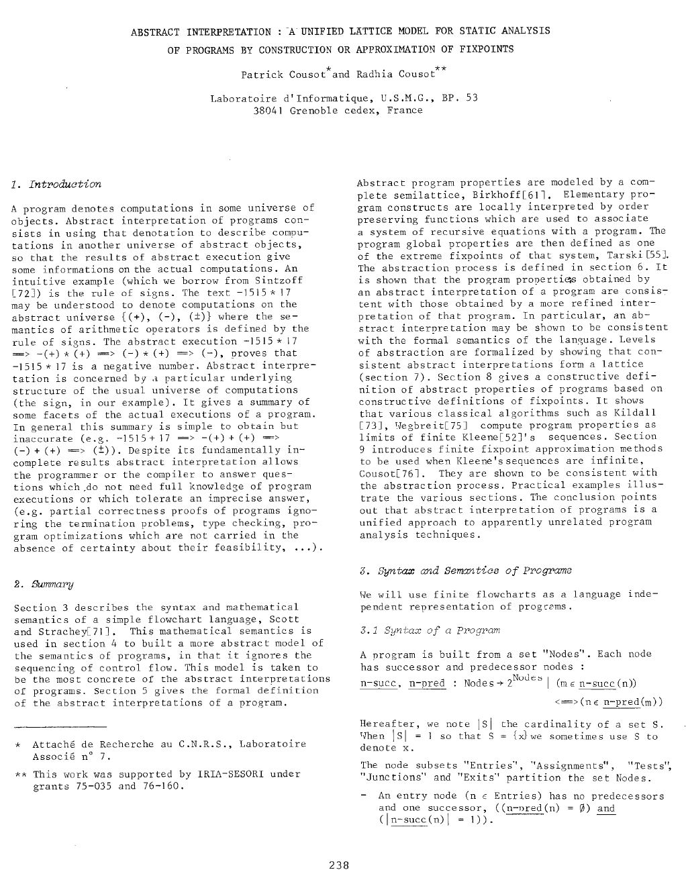
What’s behind it?
35+ years of research in abstract interpretation
Abstract interpretation?
Theory of abstractions
Ex. Sign of -123156789 * 49126589?
1. Do the multiplication: -6050272955762721
2. Use the rule of signs: - * + = -
Static analysis/verification
Precise enough to prove properties
Imprecise enough to be efficient
Most impressive industrial applications
Airbus, NASA, embedded systems, MS, Intel, etc.

Slide 9
Conclusions: Building hi quality software
Specification Language
Should be user friendly
Contracts?
Good: Easy to learn
TODO: Too low level, need more abstraction
Verification tools and science
Should help users, no need for experts
Abstract interpretation?
Good: Scalable, Automatic
TODO: Handle more complex properties, simplify development

